Slide 1
CHAPTER 10 CELL GROWTH AND DIVISION
GROWTH, DEVELOPMENT, AND REPRODUCTION

Slide 2
CELL DIVISION
THE ABILITY OF ORGANISMS TO REPRODUCE THEIR KIND IS ONE CHARACTERISTIC THAT BEST DISTINGUISHES LIVING THINGS FROM NONLIVING MATTER.
THE CONTINUITY OF LIFE FROM ONE CELL TO ANOTHER IS BASED ON THE REPRODUCTION OF CELLS VIA CELL DIVISION.
THIS DIVISION PROCESS OCCURS AS PART OF THE CELL CYCLE, THE LIFE OF A CELL FROM ITS ORIGIN IN THE DIVISION OF A PARENT CELL UNTIL ITS OWN DIVISION INTO TWO.

Slide 3
FUNCTIONS OF CELL DIVISION
REPRODUCTION
GROWTH
REPAIR

Slide 4
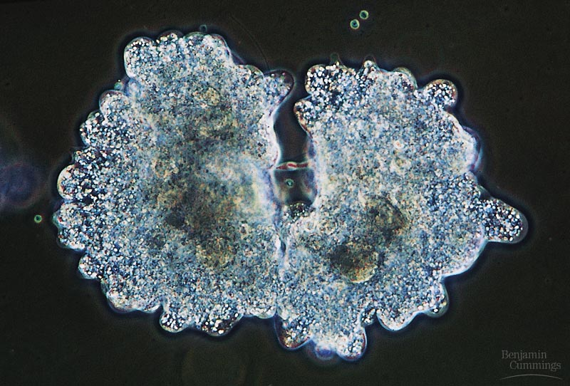
REPRODUCTION
THE DIVISION OF A UNICELLULAR ORGANISM REPRODUCES AN ENTIRE ORGANISM, INCREASING THE POPULATION.
CELL DIVISION ON A LARGER SCALE CAN PRODUCE PROGENY FOR SOME MULTICELLULAR ORGANISMS.
THIS INCLUDES ORGANISMS THAT CAN GROW BY CUTTINGS OR BY FISSION.

Slide 5
GROWTH
CELL DIVISION IS ALSO CENTRAL TO THE DEVELOPMENT OF A MULTICELLULAR ORGANISM THAT BEGINS AS A FERTILIZED EGG OR ZYGOTE.
A living thing grows because it produces more cells
As the cell grows the contents increase in diameter, volume, and surface area
When a cell is small copies of DNA produce enough mRNA to make proteins; as it increases in size it doesn’t make enough RNA so it slows down
Cell division would then take place and two daughter cells are formed

Slide 6
Controls on Cell Growth
Cells in certain places rarely divide like the heart and nervous system, while others divide rapidly like the digestive tract and our skin
When cells come in contact with other cells they stop growing
If there is an injury cells around this area respond and divide rapidly; after healing they slow down
Uncontrolled Cell Growth – Cancer
Cells have lost the ability to control their own rate of growth, even if they come into contact with other cells

Slide 7
REPAIR
MULTICELLULAR ORGANISMS ALSO USE CELL DIVISION TO REPAIR AND RENEW CELLS THAT DIE FROM NORMAL WEAR AND TEAR OR ACCIDENTS.

Slide 8
CELL DIVISION
CELL DIVISION REQUIRES THE DISTRIBUTION OF IDENTICAL GENETIC MATERIAL - DNA - TO TWO DAUGHTER CELLS.
WHAT IS REMARKABLE IS THE FIDELITY WITH WHICH DNA IS PASSED ALONG, WITHOUT DILUTION, FROM ONE GENERATION TO THE NEXT.
A DIVIDING CELL DUPLICATES ITS DNA, ALLOCATES THE TWO COPIES TO OPPOSITE ENDS OF THE CELL, AND THEN SPLITS INTO TWO DAUGHTER CELLS.

Slide 9
DNA
A CELL’S GENETIC INFORMATION, PACKAGED AS DNA, IS CALLED ITS GENOME.
IN PROKARYOTES, THE GENOME IS OFTEN A SINGLE LONG DNA MOLECULE.
IN EUKARYOTES, THE GENOME CONSISTS OF SEVERAL DNA MOLEcules

Slide 10
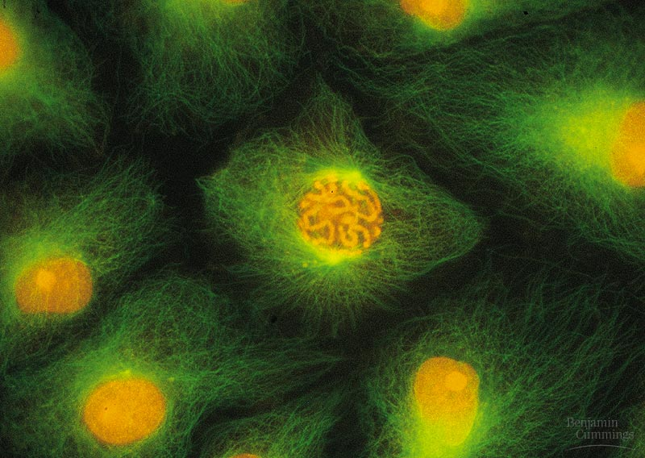
CHROMOSOMES
DNA MOLECULES ARE PACKAGED INTO CHROMOSOMES.
EVERY EUKARYOTIC SPECIES HAS A CHARACTERISTIC NUMBER OF CHROMOSOMES IN THE NUCLEUS.
HUMAN SOMATIC CELLS (BODY CELLS) HAVE 46 CHROMOSOMES.
HUMAN GAMETES (SPERM OR EGGS) HAVE 23 CHROMOSOMES, HALF THE NUMBER IN A SOMATIC CELL.

Slide 11
Chromosomes – “colored body” – contain the genetic code for inherited traits that is passed onto the next generation
- contain DNA
- the cells of every organism contain a specific # of chromosomes
- Ex: human cells – 46
dog cells – 78
- made up of chromatin – between cell divisions this forms, condenses, and dispersed regions
- composed of DNA and protein

Slide 12
DNA
EACH EUKARYOTIC CHROMOSOME CONSISTS OF A LONG, LINEAR DNA MOLECULE.
EACH CHROMOSOME HAS HUNDREDS OR THOUSANDS OF GENES, THE UNITS THAT SPECIFY AN ORGANISM’S INHERITED TRAITS.
ASSOCIATED WITH DNA ARE PROTEINS THAT MAINTAIN ITS STRUCTURE AND HELP CONTROL GENE ACTIVITY.
In 1973 Olins and Woodcock discovered that chromosomes DNA was coiled around proteins called histones
DNA and histone molecules formed beadlike structures called nucleosomes which forms a thick fiber which is short due to loops and coils which in turn is a chromosome
THIS DNA-PROTEIN COMPLEX, CHROMATIN, IS ORGANIZED INTO A LONG THIN FIBER.
AFTER THE DNA DUPLICATION, CHROMATIN CONDENSES, COILING AND FOLDING TO MAKE A SMALLER PACKAGE.

Slide 13
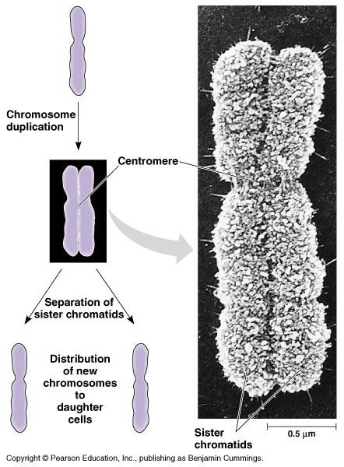
CELL DIVISION
EACH DUPLICATED CHROMOSOME CONSISTS OF TWO SISTER CHROMATIDS.
SISTER CHROMATIDS ATTACHED TO EACH OTHER AT THE CENTROMERE.
SISTER CHROMATIDS PULLED APART – ONE INTO EACH NEW CELL.
CYTOKINESIS ( DUPLICATION OF CYTOPLASM) USUALLY FOLLOWS.
NEW CELL = GENETIC EQUIVALENT OF PARENT.

Slide 14
CELL DIVISION
EACH OF US INHERITED 23 CHROMOSOMES FROM EACH PARENT: ONE SET IN AN EGG AND ONE SET IN SPERM.
THE FERTILIZED EGG OR ZYGOTE UNDERWENT TRILLIONS OF CYCLES OF MITOSIS AND CYTOKINESIS TO PRODUCE A FULLY DEVELOPED MULTICELLULAR HUMAN.
THESE PROCESSES CONTINUE EVERY DAY TO REPLACE DEAD AND DAMAGED CELL.
ESSENTIALLY, THESE PROCESSES PRODUCE CLONES - CELLS WITH THE SAME GENETIC INFORMATION

Slide 15
FERTILIZATION
IN CONTRAST, GAMETES (EGGS OR SPERM) ARE PRODUCED ONLY IN GONADS (OVARIES OR TESTES).
IN THE GONADS, CELLS UNDERGO A VARIATION OF CELL DIVISION, MEIOSIS, WHICH YIELDS FOUR DAUGHTER CELLS, EACH WITH HALF THE CHROMOSOMES OF THE PARENT.
IN HUMANS, MEIOSIS REDUCES THE NUMBER OF CHROMOSOMES FROM 46 TO 23.
FERTILIZATION FUSES TWO GAMETES TOGETHER AND DOUBLES THE NUMBER OF CHROMOSOMES TO 46 AGAIN.

Slide 16
MITOSIS
THE MITOTIC CELL CYCLE

Slide 17
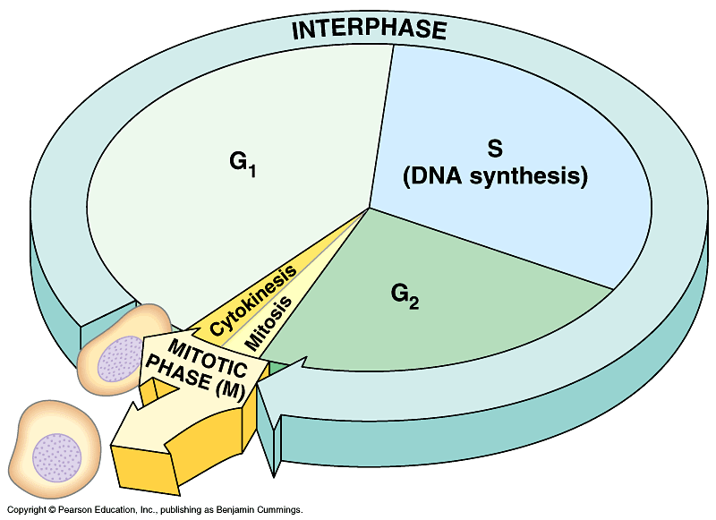
CELL CYCLE
A WELL-ORDERED SEQUENCE OF EVENTS – CELL DUPLICATES ITS CONTENTS, THEN DIVIDES IN TWO.
MITOSIS ALTERNATES WITH INTERPHASE .
THE M PHASE INCLUDES MITOSIS AND CYTOKINESIS.
INTERPHASE ACCOUNTS FOR 90% OF THE CELL CYCLE.

Slide 18
INTERPHASE
DURING INTERPHASE THE CELL GROWS BY PRODUCING PROTEINS AND CYTOPLASMIC ORGANELLES, COPIES ITS CHROMOSOMES, AND PREPARES FOR CELL DIVISION

Slide 19
INTERPHASE
INTERPHASE HAS THREE SUB-PHASES:
THE G₁ PHASE (“FIRST GAP”) CENTERED ON CELLULAR GROWTH AND DEVELOPMENT
THE S PHASE (“SYNTHESIS”) WHEN THE CHROMOSOMES ARE COPIED, DNA replication; proteins are synthesized
THE G₂ PHASE (“SECOND GAP”) WHERE THE CELL COMPLETES PREPARATIONS FOR CELL DIVISION, shortest of the three; the synthesis of organelles and materials required for division; where ATP is made
- The M Phase - cell division follows interphase and produces two daughter cells
THE DAUGHTER CELLS MAY THEN REPEAT THE CYCLE.

Slide 20
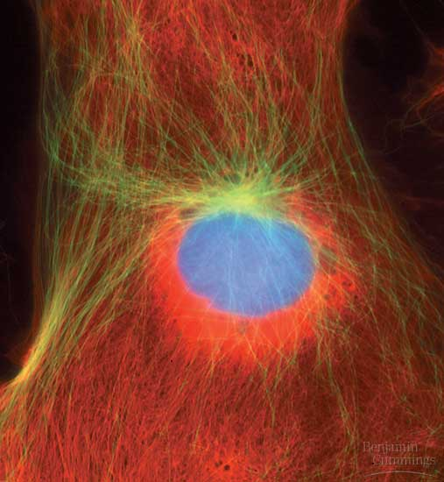
LATE INTERPHASE
BY LATE INTERPHASE, THE CHROMOSOMES HAVE BEEN DUPLICATED BUT ARE LOOSELY PACKED.
THE CENTROSOMES HAVE BEEN DUPLICATED AND BEGIN TO ORGANIZE MICROTUBULES INTO AN ASTER (“STAR”).

Slide 21
MITOSIS
MITOSIS IS A CONTINUUM OF CHANGES.
FOR DESCRIPTION, MITOSIS IS USUALLY BROKEN INTO FIVE SUB-PHASES:
PROPHASE,
PROMETAPHASE,
METAPHASE,
ANAPHASE, AND
TELOPHASE

Slide 22
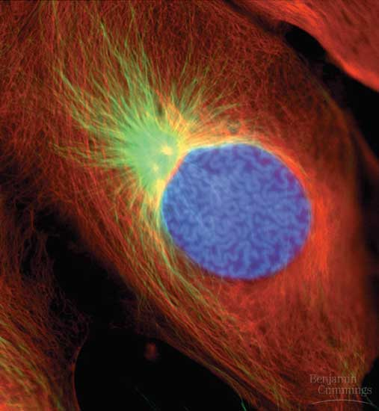
PROPHASE
IN PROPHASE, THE CHROMOSOMES ARE TIGHTLY COILED, WITH SISTER CHROMATIDS JOINED TOGETHER.
THE NUCLEOLI DISAPPEAR.
THE MITOTIC SPINDLE BEGINS TO FORM AND APPEARS TO PUSH THE CENTROSOMES AWAY FROM EACH OTHER TOWARD OPPOSITE ENDS (POLES) OF THE CELL.

Slide 23
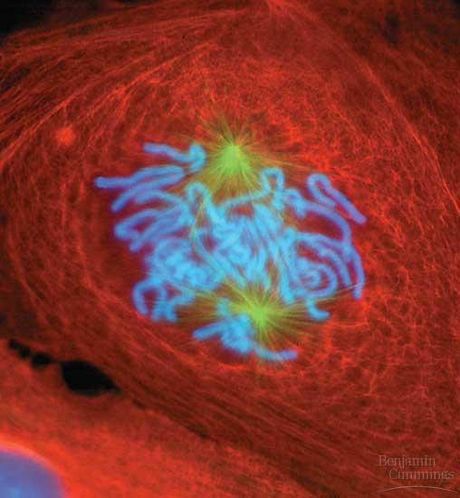
PROMETAPHASE
DURING PROMETAPHASE, THE NUCLEAR ENVELOPE FRAGMENTS AND MICROTUBULES FROM THE SPINDLE INTERACT WITH THE CHROMOSOMES.
MICROTUBULES FROM ONE POLE ATTACH TO ONE OF TWO KINETOCHORES, SPECIAL REGIONS OF THE CENTROMERE, WHILE MICROTUBULES FROM THE OTHER POLE ATTACH TO THE OTHER KINETOCHORE.

Slide 24
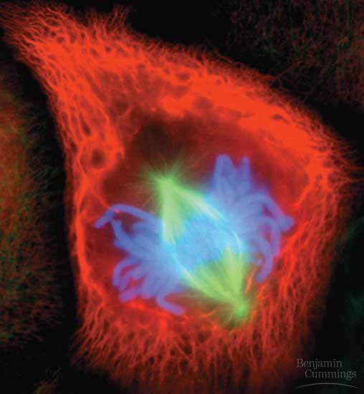
METAPHASE
THE SPINDLE FIBERS PUSH THE SISTER CHROMATIDS UNTIL THEY ARE ALL ARRANGED AT THE METAPHASE PLATE, AN IMAGINARY PLANE EQUIDISTANT BETWEEN THE POLES, DEFINING METAPHASE.

Slide 25
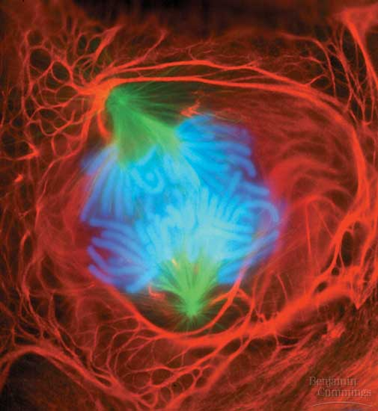
ANAPHASE
AT ANAPHASE, THE CENTROMERES DIVIDE, SEPARATING THE SISTER CHROMATIDS.
EACH IS NOW PULLED TOWARD THE POLE TO WHICH IT IS ATTACHED BY SPINDLE FIBERS.
BY THE END, THE TWO POLES HAVE EQUIVALENT COLLECTIONS OF CHROMOSOMES.

Slide 26
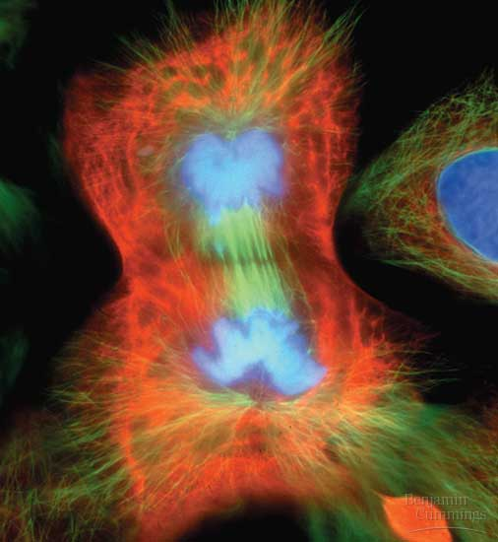
TELOPHASE
AT TELOPHASE, THE CELL CONTINUES TO ELONGATE AS FREE SPINDLE FIBERS FROM EACH CENTROSOME PUSH OFF EACH OTHER.
TWO NUCLEI BEGIN TO FORM, SURROUNDED BY THE FRAGMENTS OF THE PARENT’S NUCLEAR ENVELOPE.
CHROMATIN BECOMES LESS TIGHTLY COILED.
CYTOKINESIS, DIVISION OF THE CYTOPLASM BEGINS

Slide 27
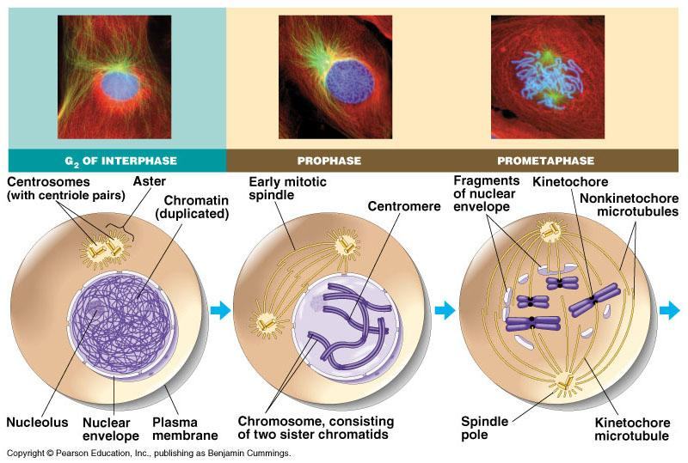

Slide 28
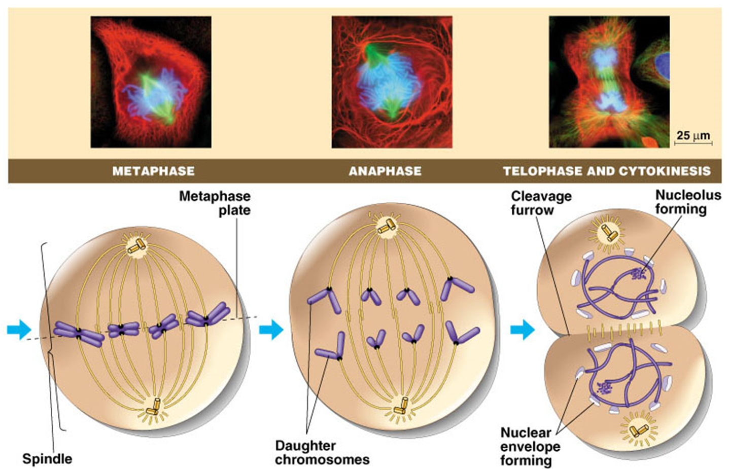

Slide 29
CELL CYCLE
LENGTH OF CELL CYCLE VARIES DEPENDING ON THE TYPE OF CELL
NERVE/MUSCLE→ RARELY DIVIDE
SKIN/STOMACH→ ONCE EVERY 24 HRS.

Slide 30
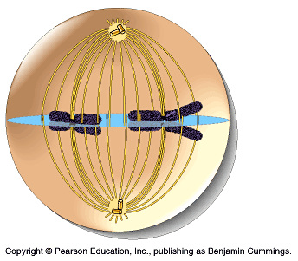
KINETOCHORES/SPINDLE FIBERS

