Slide 1
Chapter 9 CELLULAR RESPIRATION
And FERMENTATION

Slide 2
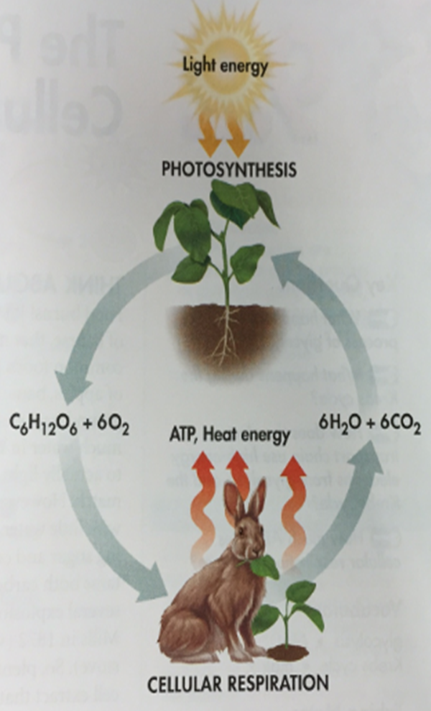
Photosynthesis vs. Respiration
-almost opposite processes
- equations are opposites
Photosynthesis- deposits energy
-occurs only in plants, algae, and some bacteria
Respiration withdraws energy
-takes place in all eukaryotes and some
prokaryotes

Slide 4
Chemical Energy In Food
Purpose of food:
Source of raw materials used to make new molecules
Source of energy
Calorie – the amount of energy needed to raise the temperature of one gram of water one degree Celsius.
Cells gradually release the energy from glucose.

Slide 5
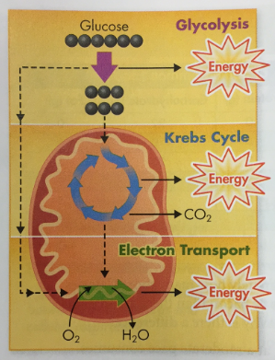
Cellular Respiration Overview
Cellular Respiration – the process that
releases energy by breaking down food molecules in the presence of oxygen.
Contains 3 Pathways:
Glycolysis
Krebs cycle
Electron transport

Slide 6
Cellular Respiration Overview
The equation for cellular respiration is:
6O₂ + C₆H₁₂O₆ → 6CO₂ + 6H₂O + ATP (energy)
If cellular respiration took place in one step, all the energy would be released at once and most would be lost as heat.
SOLUTION: Each of the three stages of cellular respiration captures some of the chemical energy available in food molecules and uses it to produce ATP or energy.

Slide 7
Step 1: Glycolysis
Process in which 1 molecule of glucose is broken in half, producing 2 molecules of pyruvic acid
Does NOT require oxygen
Location: cytoplasm
Uses: 2 stored ATP, 1 molecule of glucose
Produces: 4 ATP molecules, 2 molecules of pyruvic acid
NET GAIN: 2 ATP (2% of the total chemical energy in glucose), 2 molecules pyruvic acid

Slide 8
OXIDATIVE (AEROBIC) RESPIRATION
Respiration - process that involves oxygen and breaks down food molecules to release energy.
To get the rest of the energy from the food molecules, the cell uses oxygen.
Aerobic – requires oxygen.
the reason we need to breathe, to respire.

Slide 9
Step 2: Krebs Cycle
Location: mitochondria
Uses: the carbon from pyruvic acid (made in glycolysis) is broken down
Produces:
CO₂ (waste product, released when you exhale)
NADH
FADH₂

Slide 10
Step 3: Electron Transport
Location: mitochondria
Uses: NADH and FADH2 (from the Krebs Cycle)
- passed from one carrier protein to the next
- uses the high energy electrons
Produces: converts ADP → ATP, H₂0

Slide 11
ENERGY AND EXERCISE
Aerobic cellular respiration produces 36 total ATP molecules from each glucose molecule (37% efficient).
Remainder of energy from glucose is released as heat (body feels warm after exercise).
Eating food:
Complex carbs are broken down into simple sugars that are converted to glucose.
Lipids and proteins broken down into molecules that enter glycolysis or Krebs cycle.

Slide 12
Breathing and respiration:
Oxygen is needed to produce ATP in mitochondria
Without oxygen, the body tries to make ATP by glycolysis alone (not sufficient for most cells).
Relationship between photosynthesis and cellular respiration:
Photosynthesis produces glucose and oxygen
Cellular Respiration breaks down glucose using oxygen, to produce ATP

Slide 13
Fermentation
Process of breaking down glucose in the absence of oxygen - Anaerobic- does not require oxygen
Cells perform glycolysis followed by fermentation
(this means Krebs cycle and electron transport DO NOT occur)
Uses: 1 glucose molecule
Produces: CO2, NAD+
2 Main Types:
1. Alcoholic Fermentation
2. Lactic Acid Fermentation

Slide 14
Alcoholic Fermentation
Pyruvic Acid + NADH → ethyl alcohol + CO₂ + NAD+
Used by yeast
-(facultative anaerobes- will use aerobic respiration when oxygen is present, but if not they will use fermentation)
Products: ethyl alcohol, CO₂, and NAD+
CO₂ production causes bread dough to rise, bubbles in beer, etc.

Slide 15
Lactic acid fermentation
Pyruvic Acid + NADH → lactic acid + NAD+
Occurs during rapid exercise
- not enough oxygen to continue oxidative respiration (through Krebs Cycle and Electron Transport Chain)
Lactic acid buildup causes the painful, burning sensation in muscles after intense activity
Bacteria use this process to make foods like sour cream, yogurt, buttermilk, and sauerkraut
Why is fermentation useful?
Produces NAD+ that is used in glycolysis so that it can continue to make small amounts of ATP

